Slide 1


🛒
ShopSmart Price Tracker
01

Slide 2

Trouble tracking costs
Shopkeepers have a difficulty when it comes to tracking the expenses of their products from different suppliers. .
10

Slide 3

ShopSmart Price Tracker
Easy tracking of expenses
Compare prices
Calculate total costs
Compare different suppliers
06

Slide 4
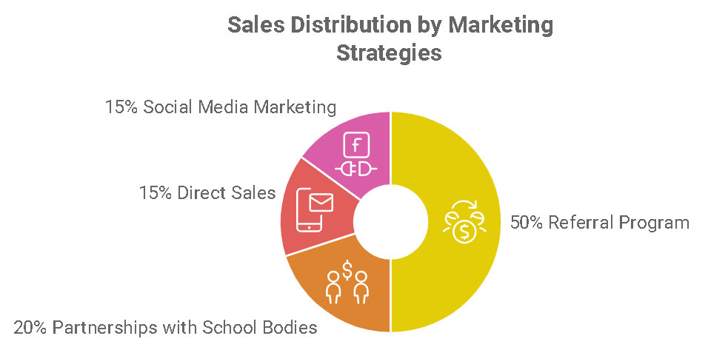
Product
Product
Tracks expenses
Compares prices for the same products
Marketing platform for enterprises
04

Slide 5



Target Market
8 out 10
8 out of 10 individuals are involved in informal work in Zimbabwe.
80%
More than 80% of Africans are involved in informal selling
1.4 billion
1.4 billion people in Africa have accedss to smart phones
14

Slide 6
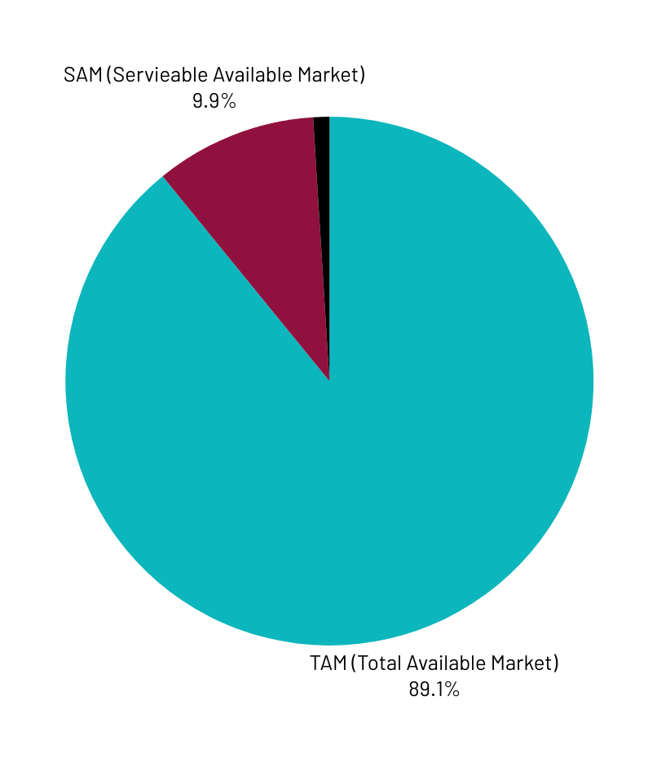
Market Size
1.4 Billion people in Africa have acces to smart phones and they make up TAM.
Of that number 10% of smart phone users could use price checking tools
Our Serviceable Obtainable Market is 1% of that number.

Slide 7

Competitors
Facebook
Tik tok
Whatsapp
23

Slide 8

Competitive Advantage
We have incorporated our competitors into our product instead of competing with them.
Our client can visit these platforms and copy prices from there.
Products are in one platform.
Expenditure management.

Slide 9
Project Traction
Tasks
Month 1
Month 2
Month 3
Month 4
Month 5
market research
software evaluation
mobile app development
mobile app deployment
market research
marketing
marketing
evaluation of objectives
23

Slide 10

Business Model
the general platform is free.
To include suppliers for different products, the user has to subscribe for $5
Companies subscribe for their newly introduced products to be listed.
Supplier Subscriptions: Small merchants pay $5/month to list products.
Enterprise Listings: Larger companies pay $50–$500/month for premium product placement.
23

Slide 11
Go To Market
Marketing to vendors at the market place in the morning.
Marketing through the vendors associations.
Marketing to companies through registration organisations.

Slide 12


Social Impact

Slide 13
Our Ask
$10000
$300 registration and formalisation of the business.
$4000 to build the software and include translation.
$5000 to market the software and idea to vendors.
$700 to brand the company

Slide 14
TEAM MEMBERS
PLP GROUP 784

Slide 15



Thank you!
Write your contacts here, social media accounts
17

